Slide 1

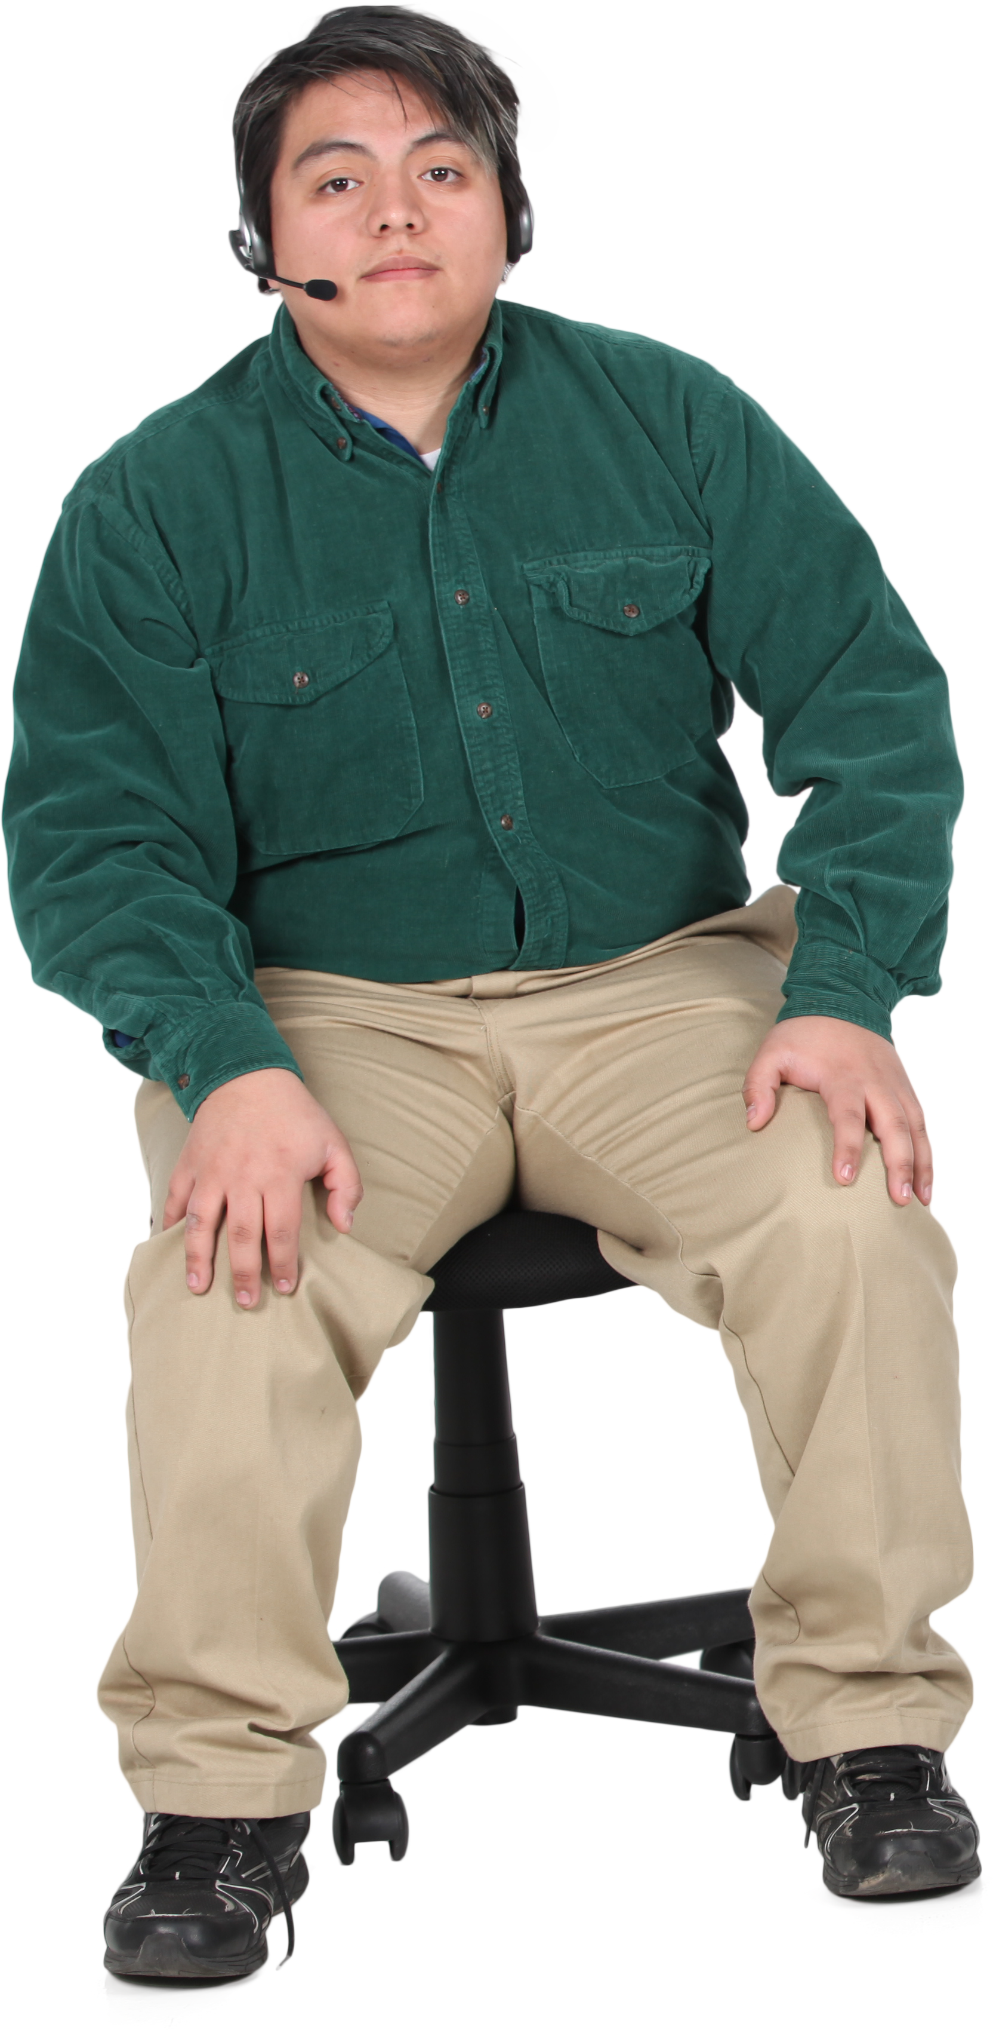
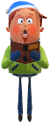


COMP5590 Software Development Group A – Patient Interface: User Stories
Group names:
- Vitalijs Strelcuks
- Joshua Shiells
- Edwin Clarke
Scott Richards
Rhys Walker

Slide 2
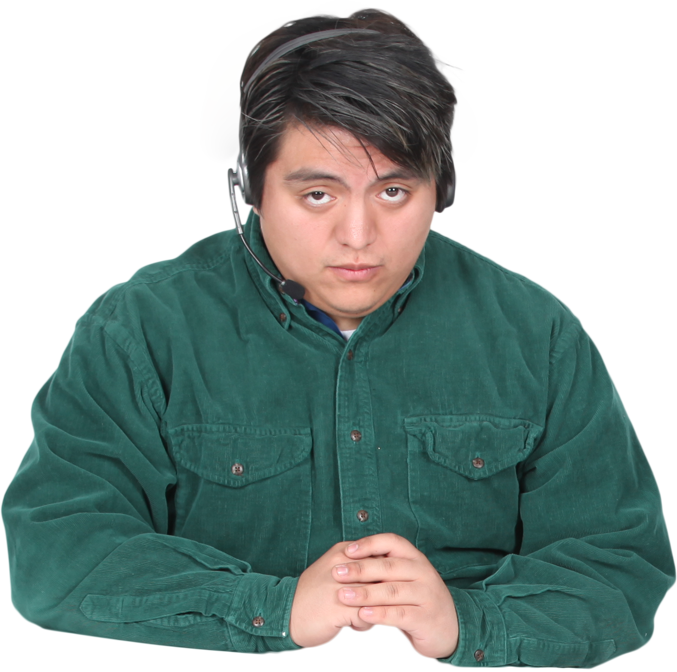

Features & Who's doing what
Groups A and D: Features of the “Patient” interface are:
[JOSH] Authentication
- [JOSH] Logging
[VIT] Register as new patient (and choose doctor and send confirmation messages).
[EDWIN] Change doctor (and send confirmation messages).
[EDWIN] Enter new booking (and send confirmation messages).
[SCOTT] View bookings.
[RHYS] Reschedule booking (and send confirmation messages).
[RHYS] View visit details and prescriptions.
[VIT] (Five people groups) View all doctors.
[SCOTT] (Five people groups) View a doctor’s details.

Slide 3

User Story 1 – Scott Richards
As a patient, I want to be able to view all my bookings so that if I forget the details of my appointment I can remind myself
This could be achieved with having a page called 'Appointments' which shows all appointments booked by the user
The page should be easily accessible (such as having a button at the top of a page and bookings should show the time, location and doctor

Slide 4
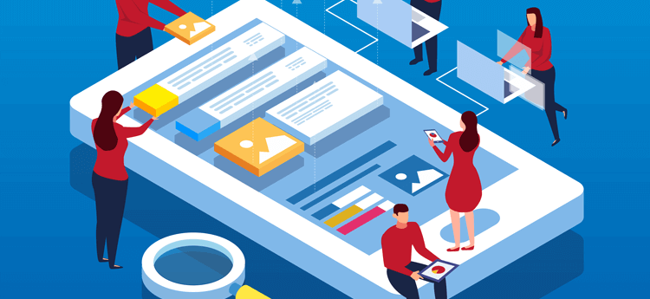
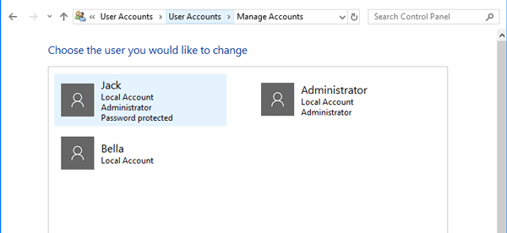
Vit’s Chosen User Story: View all Doctors
Useful to see all the doctors at the surgery.
Can potentially have filters to be able to filter by doctor profession, availability, cost, etc.
Allows user to know which doctor is right for them.
Helps user locate correct doctor on their visit to GP surgery (by viewing a picture of the doctor).
Can be achieved through implementing a button on the navigational bar, linking to the /doctors subpage. Doctors would be dynamically inserted as new elements into the DOM (document object model), accommodating an ever-growing list of them.

Slide 5
User Story 3 – Joshua Shiells
As a Patient I should be able to Login to the Platform, to be able to perform actions associated with my role.
It's important for users to be authenticated before accessing the portal. Partly so we can show the relevant information, but mostly for ensuring that no data is leaked.
In hospitals, and medical fields, Data Protection should be taken very seriously, and we as the developers need to make sure that our app is secure.

Slide 6
Rhys
- View visit details and prescriptions.
User requirement
- As a patient I would like to be able to view what the results of my visit have been. Should that be viewing my new prescription or what notes the doctor made during my visit.
Acceptance criteria
- Simple screen displaying notes from the visit
- A screen that displays a larger version of a prescription that can be printed or be viewed.

Slide 7
User stories - Edwin
As a patient, I would like the option to change the doctor for my appointment.
Acceptance criteria: make the program have the option of having all available doctors for the time available to pick.
Conversation with the user – The user wants to have a notification for confirmation.

